Slide 1
Research for MBA
Kapil Dev Subedi

Slide 2
Research in business: Concept
During last decade, dramatic changes have been occurred in business environment.
Emerging fro historical economic role, the business organization has evolved in response to the social and political mandates of national policy, technological growth, and continuing innovation in IT.
These changes have created new knowledge needs for the manager for considering any decisions.

Slide 3
Research in business: Concept
The trend toward complexity has increased the risk associated with business decisions, making it more important to have a sound information base.
The complex business decision-making environment demands that managers have more and better information on which to base decisions.
Business research is a systematic inquiry whose objective is to provide information to solve managerial problems.

Slide 4
Research in business: Concept
Business research
Complex business environment
Changing organizational problem
Management dilemma

Slide 5
Meaning and Nature of Research:
Human nature is always curious to learn, understand or investigate about the phenomenon by raising questions like why, how, what etc.
They want to know something new. That is why; human beings are the unique product of their creation and evaluation. In contrast to other forms of animal life, their more highly developed nervous system has enabled them to explore and find out the new things.

Slide 6
Research means to search again to find out something new and more about a phenomenon.
If we analyze the term 'Research', we know that it is composed of two syllables, re and search. The prefix re means again, a new or over again and the later as a verb means to examine closely and carefully, to test and try to probe.
If we combine them, they form a noun describing a careful, systematic, patient study and investigation in some field of knowledge, undertaken to establish facts or principles

Slide 7
"Research is the study of an event, problem or phenomenon using systematic and objective methods, in order to understand it better and to develop principles and theories about it" (Richards et al. 1999).
Therefore the meaning of research can be explained as a careful investigation or inquiry specially through search for new facts in any branch of knowledge.

Slide 8
Research is an organized, systematic, data based, critical, scientific inquiry or investigation into a specific problem undertaken with the objective of finding answer of solution. It is knowledge-building process. It is also a creative thinking process based on development and growth.

Slide 9
Main activities to be involved in research process are:
Define the Problem and find out the variables of study.
Get existing knowledge of inventory on the issue.
Design the research hypothesis or express question to present the problem.
Collect the data and convert them into information.
Analysis the information and conclude it to build-up theory or to generalize the situation

Slide 10
Steps of scientific research
Sensing or realizing the problem/ समस्या अनुभूत गर्नु New problems keep on emerging in the society/environment. Researchers should sense these developments occurring in the environment. This is the first steps of scientific research.
Problem identification/समस्या पहिचान गर्नु
After realization about problem the researcher should focus on the problems deeply and should identify the associated factors through further search of information. In this step the researcher try to identify what exactly are the problems in the situation.

Slide 11
Steps of scientific research
Construct the theoretical framework./ सैधान्तिक ढांचा निर्माण गर्नु
In this step the researcher make an attempt to integrate the information logically so that the reason for the problem can be conceptualized. The critical variables are examined and association among them is identified. Putting all the variables and their association together, a theoretical framework is developed.
Hypothesis formulation /परिकल्पना तर्जुमा गर्नु
Hypothesis are the logically conjectured relationship between two or more variables expressed in the form of testable statements. Hypothesis for the study are deduced from the theoretical framework.

Slide 12
Steps of scientific research
Research design / अनुसन्धान ढांचा तयार गर्नु
When the Hypotheses are narrowed down, the next step is to design or plan of attack for the research. Research design is the strategy for conduction of research. It describes the general framework for collecting, analyzing, evaluating data after identifying what the researcher wants to know?, what has to be dealt with in order to obtain required information?
Data collection / तथ्यांक संकलन गर्नु
Data collection is the field work process. In this step, the researcher ha to administer researcher instruments like questionnaire, interview schedule, and observation schedules etc. to collect data.

Slide 13
Data Tabulation and Analysis/ तथ्यांक तालिकिकरण एबम विश्लेषण गर्नु
In this step collected data are edited, tabulated, coded for its accuracy and reliability. Then different statistical tools are applied to analyze the data. The descriptive and inferential statistics are used for data analysis as per the need of research design. With the use of these statistical techniques, the hypothesis are tested.
Generalization / Development of theory and application./ सामान्यीकरण शिधान्त को बिकाश र प्रयोग
The final step involves interpretation and generalization of the findings into the larger bodies of knowledge about the phenomenon. In case of applied research, specific implementation strategy is proposed to solve the problem identified by the study.

Slide 14

The Hallmarks of Scientific Research/बैज्ञानिक अनुशन्धानका बिशेषताहरु
The hallmarks or main distinguishing characteristics of scientific research may be listed as follows:
Purposiveness /उद्देस्यपूर्ण
Rigor /बिधिसम्मत
Testability /परिक्षणयोग्य
Replicability / दुरूस्तता
Precision and Confidence/यथार्तता / बिस्वस्नियता
Objectivity/बस्तुगत
Generalizability/सामान्यीकरण
Parsimony/सरलीकृत सम्बन्ध

Slide 15
Hallmarks of Scientific Research
Purposiveness
It has to start with a definite aim or purpose.
The focus is on increasing employee commitment.
Increase employee commitment will translate into less turnover, less absenteeism and increased performance levels.
Thus it has a purposive focus.

Slide 16
2. Rigor
A good theoretical base and sound methodological design would add rigor to the purposive study.
Rigor adds carefulness, and the degree of exactitude in research.
Rigorous involves good theoretical base and thought out methodology.
These factors enable the researcher to collect the right kind of information from an appropriate sample with the minimum degree of bias and facilitate suitable analysis of the data gathered.

Slide 17
3. Testability
researcher develops certain hypothesis, then these can be tested by applying certain statistical tests to the data collected for the purpose.
The researcher might hypothesize that those employees who perceive greater opportunities for participation in decision making would have a higher level of satisfaction.

Slide 18
4. Replicability
It means that it can be used again if similar circumstances prevails.
Example:
The study concludes that participation in decision making is one of the most important factors that influences the commitment, we will place more faith and credence in these finding and apply in similar situations.
To the extent that this does happen, we will gain confidence in the scientific nature of our research.

Slide 19
5. Precision and Confidence
Precision
Precision refers to the closeness of the findings to “reality” based on a sample.
It reflects the degree of accuracy and exactitude of the results of the sample.
.

Slide 20
Confidence
Confidence refers to the probability that our estimations are correct.
That is, it is not merely enough to be precise, but it is also important that we can confidently claim that 95% of the time our results would be true and there is only a 5% chance of our being wrong.
This is also known as confidence level.

Slide 21

6. Objectivity
The conclusions drawn through the interpretation of the results of data analysis should be objective; that is, they should be based on the facts of the findings derived from actual data, and not on our subjective or emotional values.

Slide 22
7. Generalizability
It refers to the scope of applicability of the research findings in one organization setting to other settings.

Slide 23
8. Parsimony
Simplicity in explaining the phenomenon or problems that occur, and in generating solutions for the problems, is always preferred to complex research frameworks that consider an unmanageable number of factors.
For instance, if 2-3 specific variables in the work situation are identified, which when changed would raise the organizational commitment of the employees by 45%, that would be more useful and valuable to the manager than if it were recommended that he should change 10 different variables to increase organizational commitment by 48%.

Slide 24
Difficulty of applying scientific methods in social research
Complexity of subject matter
Social science deals with human beings. Human differs from each other in their activities, attitudes, motives beliefs and values.
Theses all are uncontrollable variables which are extremely complex and diverse subject.
Notes:
Social science deals with human beings. Human differs from each other in their activities, attitudes, motives beliefs and values.
Theses all are uncontrollable variables which are extremely complex and diverse subject.

Slide 25
Difficulty of applying scientific methods in social research
Difficulty in accurate measurement
In pure science, accurate measurement of variables is possible but in social science due to complex and diverse nature of variable, the accurate is not possible.
Honesty and attitude of respondent is difficult to ascertain

Slide 26
Influence of the measurement process on results
The respondents when they know that they are being observed and measured often tend to react other than normally.
Howthorne effect- effect of lighting on employee output
Difficulty of using experiment to test hypothesis
In pure science it is possible to establish meaningful laboratory condition in which the researchers may control all the variables, allow one to fluctuate and then measure the results.
However, a wider society is not a laboratory. Replication can not be carried out in social science

Slide 27
Difficulty of applying scientific methods in social research
Difficulty of making accurate prediction
In lab the scientist can predict the behavior of a dog with a great deal of precision, predicting the behavior of voters in election is not nearly so exact a science. Because, they do different things in different situation.
Consequently accurate prediction is more difficult in economics, business, politics, management than in physics and chemistry.

Slide 28
Difficulty of applying scientific methods in social research
Problematic objectives of the investigator
Scientific research demands impartiality and objective reporting of data.
Investigators become impartial in collecting data
Bias may be unconscious.
During interviewing process, the researchers may cause bias through the wording of questions or the use of leading questions

Slide 29
Basic and Applied Research
Basic Research aims to expand the frontiers of science and knowledge by verifying or disproving the acceptability of a given theory or attempting to discover more about a certain concept (non-specificity)
Example: How does motivation affect employee performance?
Applied Research focusses on a real-life problem or situation with a view to helping reach a decision how to deal with it (Specificity)
Example: Should Corporation X adopt a paperless office environment?

Slide 30
Applied Vs Basic Research
Fundamental Research
Increase the knowledge of business and its management.
Relates with universal problem.
Valuable to the society in general
Choice of topic by the researcher.
No limit of time generally.
Explains basic Social issues.
It covers more population / Sample.

Slide 31
Basic Vs Applied Research
Applied Research
Help to understand about the particular business problem.
Finds the solution of particular problem.
New knowledge limited to a problem.
Researcher is given the topic.
Tight time scale.
Practical problem solving.
It relates with specific sample/units /case.

Slide 32
The Value of Business Research for Managers – (1)
Reduction of uncertainty and improvement in the quality of decision-making with several consequent advantages (e.g. strategic, operational) and benefits for organizations
Business Research Methods can be employed in each of the following four stages:
Identification of problems and/or opportunities
Useful for strategy planning, analysis of internal and external organizational environment

Slide 33
The Value of Business Research for Managers – (2)
(2) Diagnosing and Assessment of problems and/or opportunities
Its purpose is to gain insight into the underlying reasons and causes for the situation. If there is a problem, it asks what happened and why? If there is an opportunity, it seeks to explore, clarify and refine the nature of the opportunity and, in the case of multiple opportunities, seeks to set priorities
(3) Selection and Implementation of Courses of Action
After alternative courses of action have been determined, selection of the best possible course.

Slide 34
The Value of Business Research for Managers – (3)
An important consideration is the quality of forecasting which is an essential tool of research
(4) Evaluating the Course of Action
Business Research Methods are used after a course of action has been implemented in order to determine whether activities have been properly implemented and have accomplished what they intended to do

Slide 35
Role of research in management
Research helps in identifying and formulating the management problems/ issues
Business research as a systematic enquiry and provides information to solve Managerial problems.
Dramatic changes in business environment have brought up the lot of issues in business and management which requires the better quality information to address those issues.

Slide 36
Complex and vibrant business environment have demanded new knowledge needs for the managers to consider when evaluating any decisions.
Research provides better information to solve the business problems with mergers, trade policies, technology transfer, opening up the borderless markets and macro economic savings - investment issues.

Slide 37
ROLE OF RESEARCH IN DECISION-MAKING
Decision-making is the process of selecting the best alternative from the available set of alternatives.
Management is chiefly concerned with decision-making and its implementation.
These decisions should be based on appropriate studies, evaluations and observations.
Research provides us with knowledge and skills needed to solve the problems and to meet the challenges of a fast paced decision-making environment.

Slide 38
Nature of Research
Exploration: Exploring the reality to identity the problem and the variables causing it or related with it. Exploration of the problem is accomplished through familiarization with the available literature, interviews with experts, focus groups, or some combinations. Exploration adds some preliminary knowledge and facts about the phenomena.
Description: Description adds more to our existing knowledge explaining the nature of variables involved, their inter relationship and the multiple effects of the factors impinging on a situation. To discover answers to the questions who, what, when, where and some times how is the description.

Slide 39
Explanation : An explanation goes beyond description and attempts to explain the reasons for the phenomenon (that the description only observes the phenomena). In an explanatory purpose, the researchers uses theories or at least hypothesis to account for the forces that caused a certain phenomena to occur.
Prediction : If we can provide a plausible explanation for an event after it has occurred; it desirable to be able to predict when and in what situation the event will occur. The possible relationship between the factors and the particular event, help the researchers to frame a verifiable generalization that explain how the variables involved behave in certain situation.

Slide 40
Nature / type of management research
Policy Research: Research designed to analyze situations at the strategic level and to formulate overall policy proposals.
Managerial Research: is related to the specific problem of limited scope for which management has need of additional information for decision-making. (Feasibility study of new product)
Action Research: Continuous collection and analysis of data during the normal on going operation of the business so as to make routine / normal business decisions.
Evaluation Research: It is the research oriented toward formal and objective measurement of the extent which a given action, activity or programme has achieved its original objective.

Slide 41
When Should Business Research be Undertaken?
Is sufficient time
available?
NO
Yes
Is information
inadequate?
Do not
undertake Business Research
Yes
High importance
of decision?
Yes
Research benefits
greater than costs?
Undertake Business Research

Slide 42
Value and Costs of Undertaking Business Research
VALUE
COSTS
Decreased Uncertainty
Higher Likelihood of Correct Decisions
Better Business performance
Higher Profits
Better Reputation
Research Costs
Delay in Making Business Decisions
Disclosure of Information to Rivals
Possibility of Error

Slide 43
Applying scientific thinking to business problems
What is Science ?- Science has been defined as “the methodological and systematic approach to acquisition of new knowledge” (Geoffrey Marcyzk, David Festinger, 2005)
What is and the Scientific Method ?- The scientific method, which has evolved since the 13th century, concerns the set of tools, techniques and procedures used by basic and applied researchers to analyze and understand phenomena and prove or disprove prior conceptions.

Slide 44
The Essence of the Scientific Method
Characteristics of the Scientific Method
Objectivity
Systematic Analysis
Logical Interpretation of Results
Elements of the
Scientific Method
Empirical Approach
Observations
Questions
Hypotheses
Experiments
Analysis
Conclusion
Replication
General Laws
Basic
Research
Scientific
Method
Applied
Research
Information or
Ideas for alternative
Courses of action

Slide 45
Solving management Problems
Scientific thinking helps us solve all types of problems we confront in organization and management.
Scientific thinking involves
observations
defining a problem
construction of explanations
evaluation of possible explanations or solutions to the problem

Slide 46
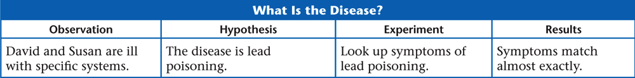
B. Using Scientific Thinking to Solve a Problem

Slide 47
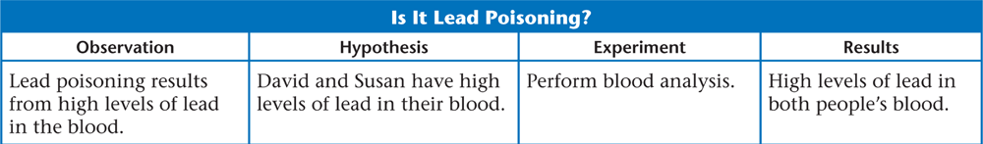
B. Using Scientific Thinking to Solve a Problem
David and Susan have symptoms of lead poisoning

Slide 48
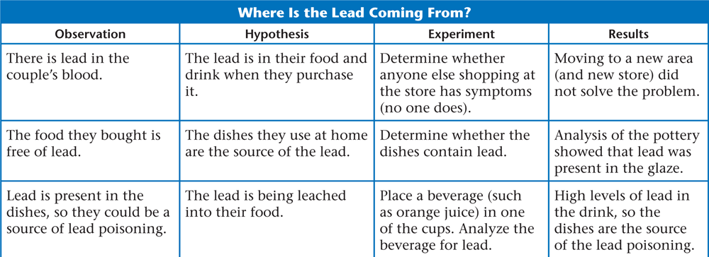
B. Using Scientific Thinking to Solve a Problem
No other customers have symptoms – lead is not from food

Slide 49
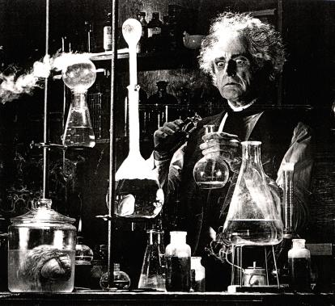
C. The Scientific Method
The scientific method is a procedure for processing the information that flows from the world around us in which we:
Make observations
Formulate hypotheses
Perform experiments to
test our hypotheses

Slide 50
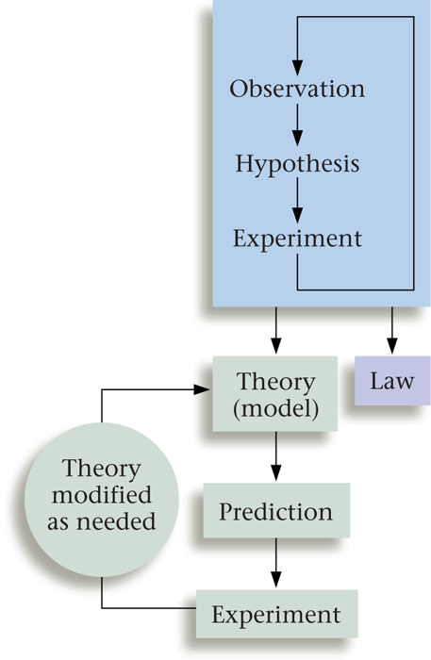
C. The Scientific Method

Slide 51
Why managers should Know research
Managers have to make decision to prepare the organizational activities.
They have to decide different plan, policies and programs continuously to achieve desired goals.
The success of an organization depends on quality of decision taken by manager. Appropriate decisions have to be taken in right time for success.
Decision cannot be taken in vacuum. They must be based and backed by information. A manager should have right and adequate information in different stapes of management process.

Slide 52
Why managers should Know research
Information should be collected and processed before their utilization. The information system must be established in an organization to acquire the information in time. The sub-system of an information system are:
Internal Information sub-system
External Information sub-system
Research information sub-system which studies to a problem to find out the effective solution. Managers have to focus attention on it to fulfill the needs of information to take an appropriate decision.
Research is necessary in every management functions and process. Hence a manager should have knowledge and skill of research methodology to solve their business problems.

Slide 53
Ethical issues in research
Put pressure on the participants to grant access to information
Violate an individual’s right to privacy
Force respondents to provide personal and confidential data.
Possible deception of participants
Fabricate the entire set of data.
Select only the best data for reporting
Claim credit for the work done by others
False reporting of data or event.
Not maintaining confidentiality and anonymity.
Report data without permission from the organization.
Publish the same paper in two different journals without telling the editors

Slide 54
For ethical research
Honesty -Honest reporting data, results, methods and procedures, and publication status.
Objectivity- unbiased and impartial explanation of research design, data interpretation, peer review and so on.
Integrity-act with sincerity and strive for consistency of thought and action.
Carefulness-keep good records of research activities and avoid careless errors and negligence.
Legality-know and obey relevant laws and institutional and governmental policies.

Slide 55
For ethical research
Non-discrimination-avoid discrimination against anybody on the basis of sex, race, ethnicity, language or other factors.
Confidentiality- protect confidential communications, such as personal records, correspondence, trade secrets, and patient records.
Respect for intellectual property-honour patents, copyrights, and other forms of intellectual property. do not use data or other documents without permission. Give credit where credit is due

Slide 56
Meaning | Data requirements and analysis | Research objectives
Policy research -To formulate major policy proposal -To establish their priorities -To identify their implications | -Macro level data about environmental forces, -Organizational situations and competitive factors -Longitudinal data -Time series data | -Identifications of policy options -Identifications of policy priorities for the organizations
Managerial research -To study the ongoing operations or projects -To help in improving managerial effectiveness -To help in decision making | -Specific and detailed data about the operations or projects -Data collections through MIS -Collections of qualitative data -Exploring the situations for in depth understanding §Survey research methods §Observational methods §Experimental methods | -Identification of the problem situation -Identification of decision options -Precise recommendations for actions to be taken
Action research -To feed the information into the organization -To improve functioning -To improve managerial action -To suggest future courses of actions | Continuous gathering and analysis of data -Problem specific data -Opinion surveys -Observations -Satisfaction level -Morale surveys -Frustration index | To recommend the action to be taken with regard to -Organizational structure -Rules -Reward and punishment system -Performance evaluation -Work environment
Evaluation Research -To measure achievements against the objectives -To identify gaps and problem areas -To suggest the improvements required | -Micro level data -Program review and evaluation data -Comparative performance -Internal surveys | -Identification of programme strength and weaknesses -Recommendation for programme improvements

